Slide 1
Collated slides presented at the NMPA launch event on 9th November 2017

Slide 2
Introduction to the National Maternity and Perinatal Audit

Slide 3
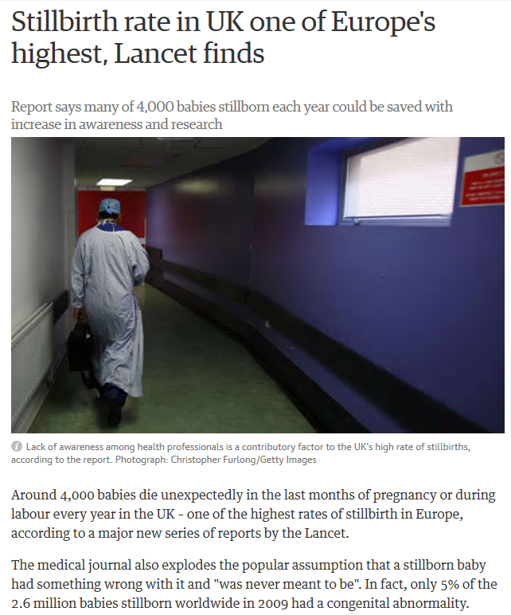


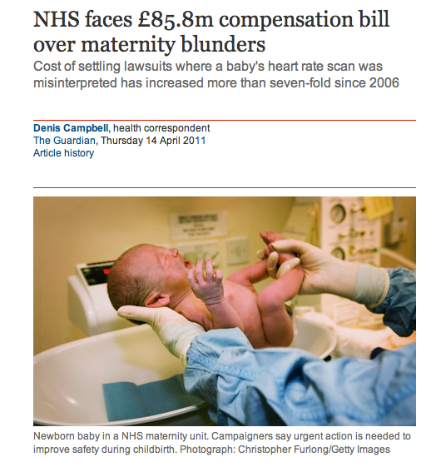
Rationale
Rates of stillbirth and maternal mortality are higher than in many European countries
Growing body of evidence pointing towards variation in outcomes
Countless inquiries concluding e.g. “the majority of births are safe, but some births are less safe than they could, and should be” Kings Fund (2008)
£100 million in litigation costs over 10 years – higher than any other clinical specialty

Slide 4
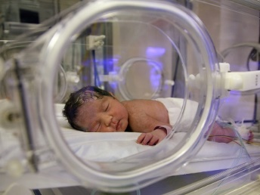

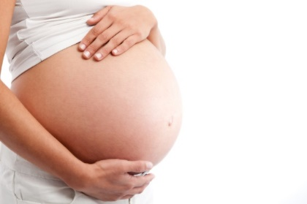


Rationale
NNAP
MBRRACE - 5.1 per 1000 babies
Each Baby Counts – 1.6 per 1000 babies
8% of babies
MBRRACE - 8.5 per 100,000 women
UKOSS - few hundred women per year
NMPA - 750,000 birth per year

Slide 5
The NMPA approach
Audit of all mothers and babies cared for by NHS maternity services
Strong clinical, service user and methodological involvement at every level
Extensive use of available data sources and record linkage
Not limited to traditional ‘auditable standards’, of which relatively few exist and are measurable

Slide 6




History of the NMPA
2014 – Pre-tender prioritisation project
2015 – Funding secured; competitive tender announced
2016 – Contract awarded in July (until June 2019)
2017 – Year 1: 2 reports published
Funded by
Commissioned by
Notes:
Who is responsible
Potted history …From conception to birth! Long gestation in human terms but actually relatively short in audit terms
3 colleges and LSHTM put in a successful bid
Northern Ireland
funded the project for three years in the first instance
HQIP – same governance as Maternal, Newborn and Infant Clinical Outcome Review Programme, NNAP and PMRT: Maternal, Newborn and Child Health Procurement Framework Agreement .

Slide 7
















Clinical Reference Group
Project Team
Women and Families Involvement Group

Slide 8
Independent Advisory Group
Project Board
Clinical Reference Group
Project Team
Women and Families Involvement Group

Slide 9
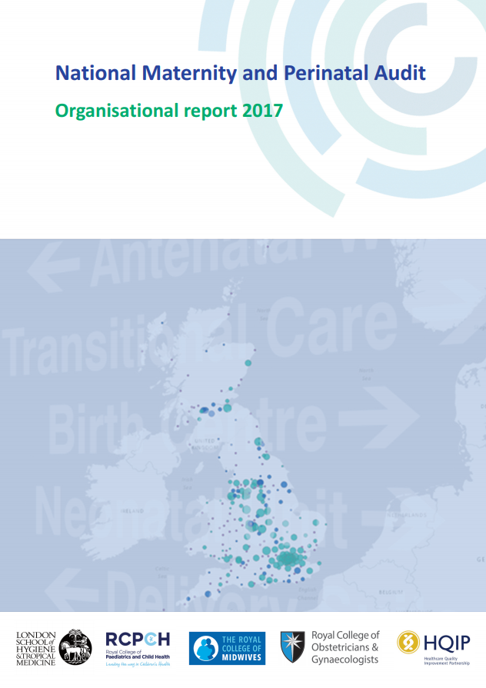
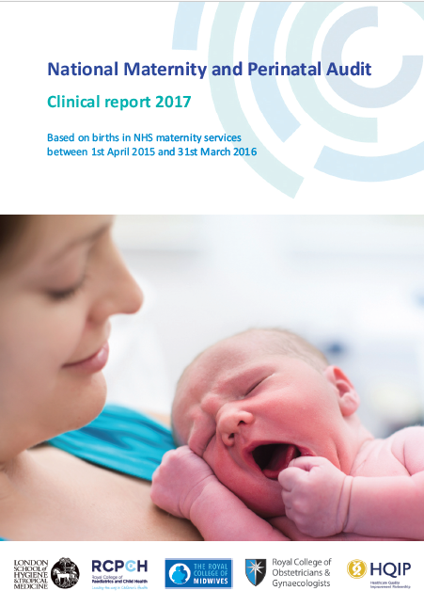
The NMPA has three main elements
An organisational survey
A continuous clinical audit
A programme of periodic sprint audits

Slide 10
Timescales
 | 2017 |  |  |  | 2018 |  |  |  | 2019
 | Jan-Mar | Apr-Jun | Jul-Sep | Oct-Dec | Jan-Mar | Apr-Jun | Jul-Sep | Oct-Dec | Jan-Mar | Apr-Jun
Organisational survey report |  |  | Aug |  |  |  |  |  |  | Jun
Continuous clinical audit reports |  |  |  | 15/16 births |  |  | 16/17 births |  |  | 17/18 births
“Sprint” audit reports |  |  |  |  |  |  | x2 |  |  | x2
Topics:
Pregnant or postpartum women admitted to intensive care
Babies admitted to neonatal care
Topics:
Maternal and neonatal blood-stream infections
Perinatal mental health

Slide 11
National Maternity and Perinatal Audit
Organisational survey 2017
A snapshot of NHS maternity and neonatal services
in England, Scotland and Wales in January 2017

Slide 12
Organisational survey aims
Provide context to NMPA clinical audit and sprint audits
Identify organisational factors which may contribute to variation
Where available, compare to standards/recommendations

Slide 13
Methods
Organisational report 2017
#NMPA2017
Stakeholder input and reference to recommendations
Online survey
Piloted with 9 diverse trusts and boards
Sections completed by those deemed locally to be best placed
100% - thank you!
Response rate

Slide 14
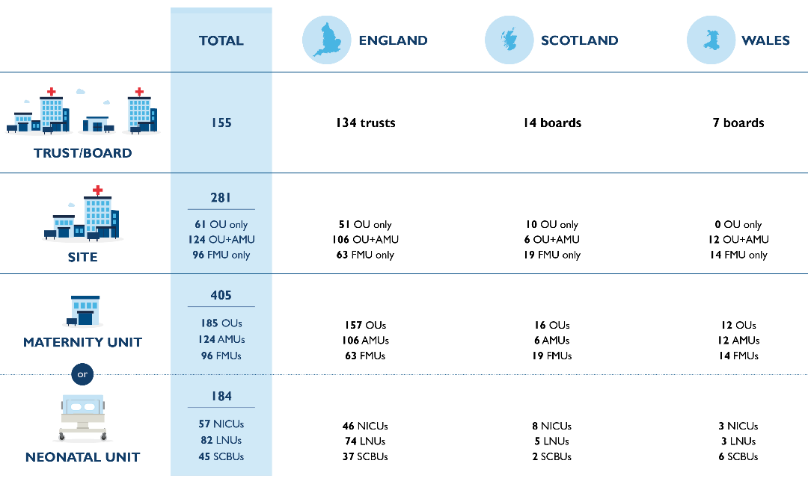
Reporting levels

Slide 15
Themes
Organisational report 2017
#NMPA2017
Settings
Services
Staffing
Snapshot of the organisation of care at start of 2017
www.maternityaudit.org.uk

Slide 16
Settings
Organisational report 2017
#NMPA2017
Notes:
Settings

Slide 17
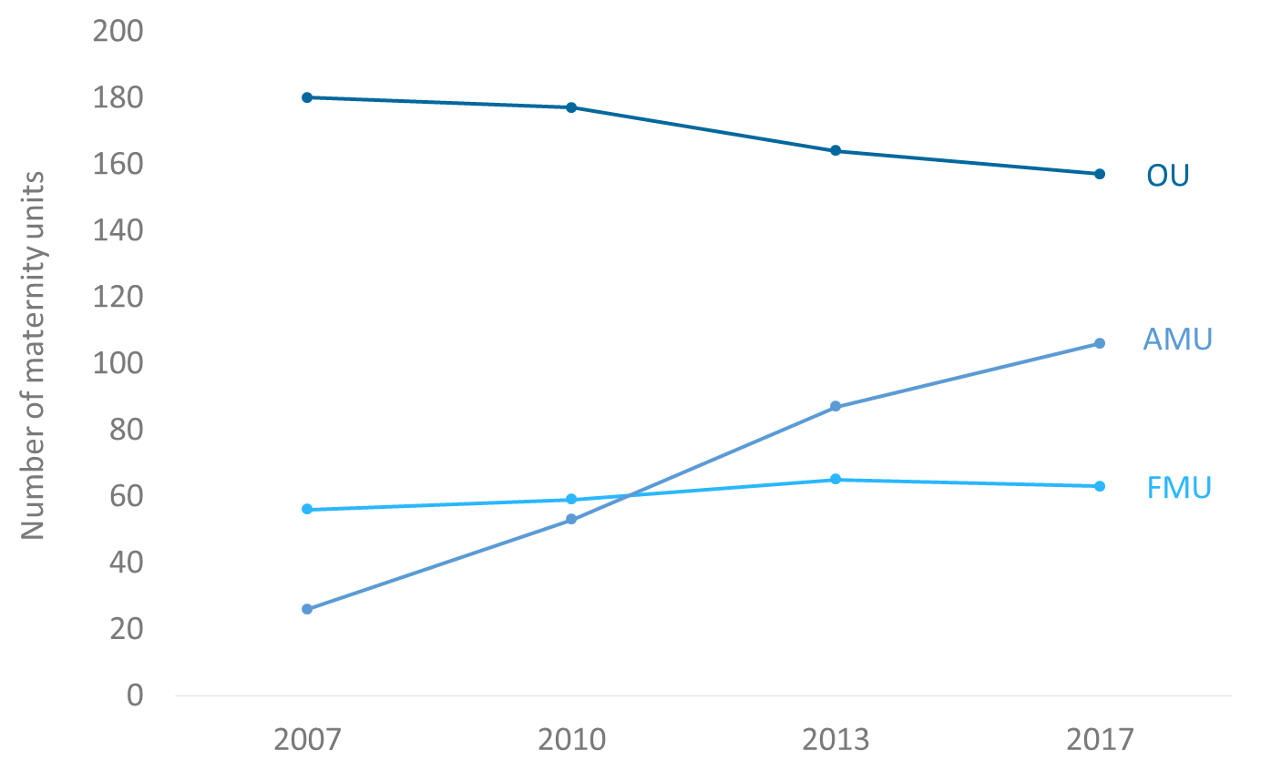
Trend in maternity unit types 2007-2017 (England)
OU - Obstetric unit AMU - Alongside midwifery unit FMU - Freestanding midwifery unit

Slide 18
Birth settings available per trust/board
Organisational report 2017
#NMPA2017

Slide 19

Geographical spread maternity unit types

Slide 20
Neonatal unit designation and number of births on site
Special Care Baby Unit Local Neonatal Unit Neonatal Intensive Care Unit

Slide 21
Geographical spread neonatal units
Organisational report 2017
#NMPA2017

Slide 22
Services
Organisational report 2017
#NMPA2017

Slide 23
Antenatal and postnatal community care
Organisational report 2017
#NMPA2017
Antenatal appointments: 63% of services offer choice of time and 82% of location
Postnatal care: 48% offer choice home visits or clinic
Planned number of postnatal contacts for healthy women and babies ranges from 2 to 6 (median 3).
Fewer contacts in England than in Scotland and Wales

Slide 24
Service availability: transitional care
Organisational report 2017
#NMPA2017

Slide 25
Service availability: joint cardiac clinics
Organisational report 2017
#NMPA2017

Slide 26
Availability of facilities for obstetric haemorrhage
Organisational report 2017
#NMPA2017

Slide 27
Electronic information sharing
Organisational report 2017
#NMPA2017
97% of trusts/boards use an electronic maternity system
but
Half report that community midwives do not have access to women’s full electronic maternity record at all times,
and over 20% that they do not have access at their community base
Only a tenth report that women can access their electronic maternity record

Slide 28
Multiprofessional training
Organisational report 2017
#NMPA2017

Slide 29
Staffing
Organisational report 2017
#NMPA2017

Slide 30
Community midwifery team size
Organisational report 2017
#NMPA2017
38% of trusts/boards used some form of caseloading
44% had some or all midwives working in an integrated way
92% had community midwives organised into teams

Slide 31
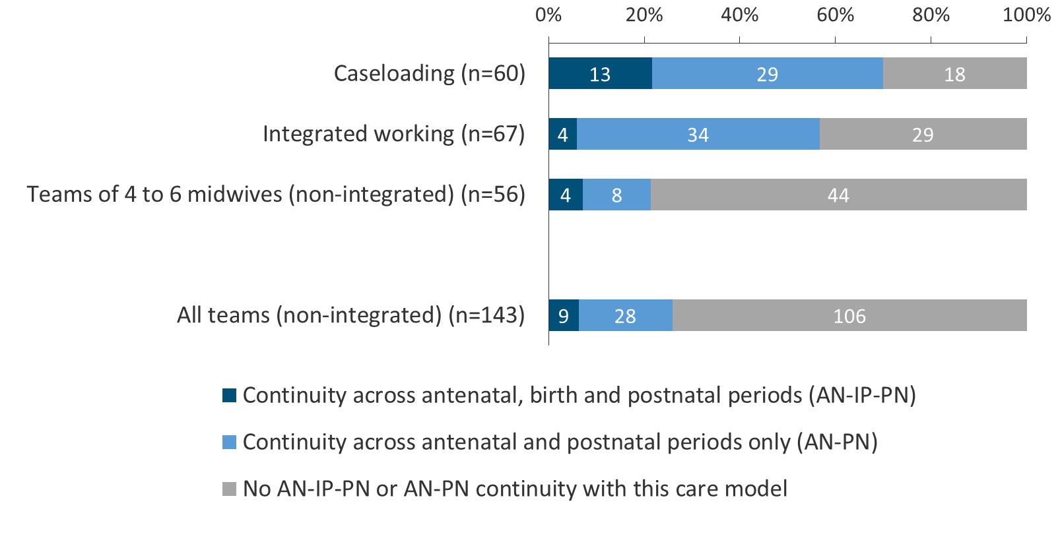
Level of continuity of carer provided with different care models
(as estimated by respondents)
Organisational report 2017
#NMPA2017

Slide 32
Midwifery skill mix per trust/board
Organisational report 2017
#NMPA2017
Scotland
Band 2
Band 6
England
Wales

Slide 33
Obstetric senior presence
Organisational report 2017
#NMPA2017

Slide 34
Neonatal senior presence
Organisational report 2017
#NMPA2017

Slide 35
Summary
Organisational report 2017
#NMPA2017
Variation in services available; ‘typical’ units do not exist
Variation in staffing provision
Maternity and neonatal service configuration in constant flux
Overall, more than three quarters of trusts/boards offer homebirth, at least one type of midwifery unit, and an obstetric unit

Slide 36
Full report and results per service available from www.maternityaudit.org.uk
Next organisational survey in 2019
Organisational report 2017
#NMPA2017

Slide 37
National Maternity and Perinatal Audit
Clinical Report 2017
Methodology
Based on births in England, Scotland and Wales from 1st April 2015 to 31st March 2016

Slide 38
Clinical Report 2017
Based on births in England, Scotland and Wales
from 1st April 2015 to 31st March 2016
Introduction
Data collection
Preparing data for analysis
Deriving audit measures
Analysis: in-house

Slide 39



Clinical Report 2017
Based on births in England, Scotland and Wales
from 1st April 2015 to 31st March 2016
Data Collection
3 countries with separate data collection systems; 1 national audit
Maternity Data Source | Trusts’ local maternity IT systems - directly sent to RCOG | Maternity Indicators data set | Scottish Morbidity Record-02/Scottish Birth Record
Linked to | Hospital Episode Statistics | Patient Episode Database for Wales | Scottish Morbidity Record-01

Slide 40
Clinical Report 2017
Based on births in England, Scotland and Wales
from 1st April 2015 to 31st March 2016
Why link maternity data with hospital admissions data?
Further detail on
  obstetric history
  diagnoses
Patterns over time & readmissions

Slide 41
Clinical Report 2017
Based on births in England, Scotland and Wales
from 1st April 2015 to 31st March 2016
Preparing data for analysis
Trusts
129 trusts
96% participation
Thank you!
NMPA secure server
IDs
Clinical data

Slide 42
Clinical Report 2017
Based on births in England, Scotland and Wales
from 1st April 2015 to 31st March 2016
Preparing data for analysis
NMPA
IDs
Study ID
Clinical data
Study ID

Slide 43
Clinical Report 2017
Based on births in England, Scotland and Wales
from 1st April 2015 to 31st March 2016
Preparing data for analysis
NMPA
NHS Digital Analysis
IDs
Study ID
Clinical data
Study ID

Slide 44
Clinical Report 2017
Based on births in England, Scotland and Wales
from 1st April 2015 to 31st March 2016
Preparing data for analysis
NHS Digital
NMPA
IDs
Study ID
HES

Slide 45
Clinical Report 2017
Based on births in England, Scotland and Wales
from 1st April 2015 to 31st March 2016
Preparing data for analysis
NMPA
Analysis
Study ID
HES
Clinical data
Study ID

Slide 46
Clinical Report 2017
Based on births in England, Scotland and Wales
from 1st April 2015 to 31st March 2016
Preparing data for analysis
NWIS holds
ISD holds
NMPA has access to these linked datasets
Pseudonymised ID
PEDW
Clinical maternity data
Pseudonymised ID
SMR-01
Clinical maternity data

Slide 47
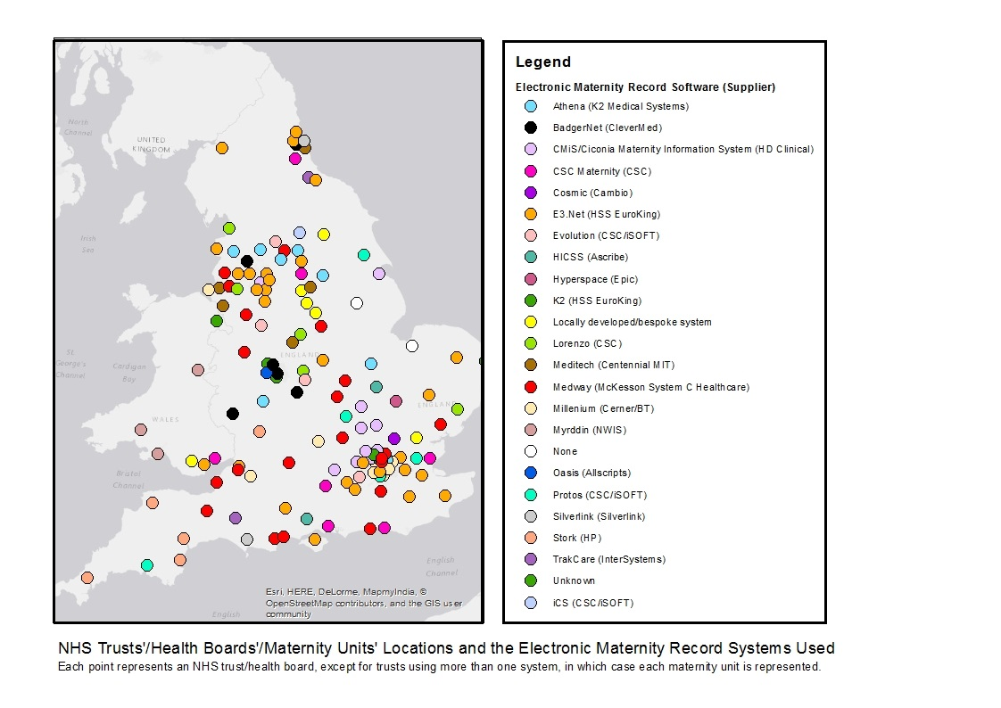
Clinical Report 2017
Based on births in England, Scotland and Wales
from 1st April 2015 to 31st March 2016
Preparing data for analysis
More than
20 systems
Hospitals can
adapt their
systems
Between
2 hours &
2 weeks to
prepare
each trust’s
data

Slide 48
Clinical Report 2017
Based on births in England, Scotland and Wales
from 1st April 2015 to 31st March 2016
Case Ascertainment

Slide 49
Clinical Report 2017
Based on births in England, Scotland and Wales
from 1st April 2015 to 31st March 2016
Data Quality
Site level data quality checks:
Data completeness (more than 70%)
Plausible distribution (e.g. gestational age mostly term)
Internal consistency checks (e.g. no C-sections in freestanding midwifery led units)

Slide 50
Clinical Report 2017
Based on births in England, Scotland and Wales
from 1st April 2015 to 31st March 2016
Data Quality
Analysis in NMPA report is restricted to:
Sites that pass NMPA data quality checks
Birth records within those sites that contain the required data to construct a measure
The number of sites for which results are available therefore varies from measure to measure, depending on specific data requirements

Slide 51
Clinical Report 2017
Based on births in England, Scotland and Wales
from 1st April 2015 to 31st March 2016

Slide 52
Clinical Report 2017
Based on births in England, Scotland and Wales
from 1st April 2015 to 31st March 2016

Slide 53
Clinical Report 2017
Based on births in England, Scotland and Wales
from 1st April 2015 to 31st March 2016
Introduction
Data collection
Preparing data for analysis
Deriving audit measures
Analysis: in-house

Slide 54
Clinical Report 2017
Based on births in England, Scotland and Wales
from 1st April 2015 to 31st March 2016
Initial long-list of 60 audit measures
Long-list refined based on clinical relevance and overall usefulness to our audience
Further refinements based on:
  Feasibility
  Data quality
  Statistical power

Slide 55
Audit measure category | Measure title
Antenatal care | Proportion of women who were smokers at booking who smoke at the time of birth
Intrapartum Care | Proportion of women with induced labour
 | Proportion of women with a spontaneous vaginal birth
 | Proportion of vaginal births with an episiotomy
 | Proportion of women having an instrumental birth
 | Proportion of women having a caesarean section
 | Proportion of elective deliveries performed at <39 weeks of gestation without a documented clinical indication
 | VBAC rate
Maternal morbidity | Proportion of vaginal births with a 3/4th degree perineal tear
 | Proportion of women with severe PPH (>1500ml)
 | Proportion of women readmitted to hospital as an emergency within 42 days of giving birth
Neonatal | Proportion of small-for-gestational age babies born ≥37 weeks who are not delivered before 40+0 weeks
 | Proportion of singleton, term, liveborn infants with a 5-minute Apgar score of less than 7
 | Proportion of liveborn babies with skin to skin contact within 1 hour of birth
 | Proportion of liveborn babies who are given breast milk at first feed
 | Proportion of liveborn babies who are given breast milk at discharge home

Slide 56
Clinical Report 2017
Based on births in England, Scotland and Wales
from 1st April 2015 to 31st March 2016
Analyses designed for maximum comparability
Adjusted for risk factors outside of the trust or health board’s control
Denominators chosen for relevance and uniformity
  Relevance: “vaginal births only for 3rd/4th degree tears”
  Uniformity: “singleton births only”

Slide 57
Clinical Report 2017
Based on births in England, Scotland and Wales
from 1st April 2015 to 31st March 2016
Adjustment was performed using logistic regression
Logistic regression calculates the probability of an outcome for each woman based on her individual risk factors
Probabilities summed at site level to give the expected rate
Adjusted rate = observed/expected*national mean
Risk Factors
Maternal age
Ethnicity
Deprivation quintile
Parity
BMI
Smoking
Previous Caesarean section
Gestational age
Birthweight
Pre-existing hypertension
Pre-existing diabetes
Gestational diabetes
Pre-eclampsia/eclampsia
Placenta praevia/abruption
Poly/oligo/anhydramnios

Slide 58
Elective CS – multiparous women
Clinical Report 2017
Based on births in England, Scotland and Wales
from 1st April 2015 to 31st March 2016
Pre-adjustment

Slide 59
Elective CS – multiparous women
Clinical Report 2017
Based on births in England, Scotland and Wales
from 1st April 2015 to 31st March 2016
Pre-adjustment

Slide 60
Elective CS – multiparous women
Clinical Report 2017
Based on births in England, Scotland and Wales
from 1st April 2015 to 31st March 2016
Post-adjustment

Slide 61
Clinical Report 2017
Based on births in England, Scotland and Wales
from 1st April 2015 to 31st March 2016
Conclusions
High-quality Great Britain dataset
Some variables linked for the first time
Never before possible national analyses
Adjustments allowing the results to be used for national comparison

Slide 62
National Maternity and Perinatal Audit
Clinical Report 2017 - Key Findings
Based on births in England, Scotland and Wales from 1st April 2015 to 31st March 2016

Slide 63
Introduction
96% of trusts contributed data to the clinical report
92% of births are ascertained in the dataset
Selection of measures through a process of evaluation – clinical relevance, power, and feasibility
New information
Robust risk adjustment

Slide 64
Contextual Findings

Slide 65
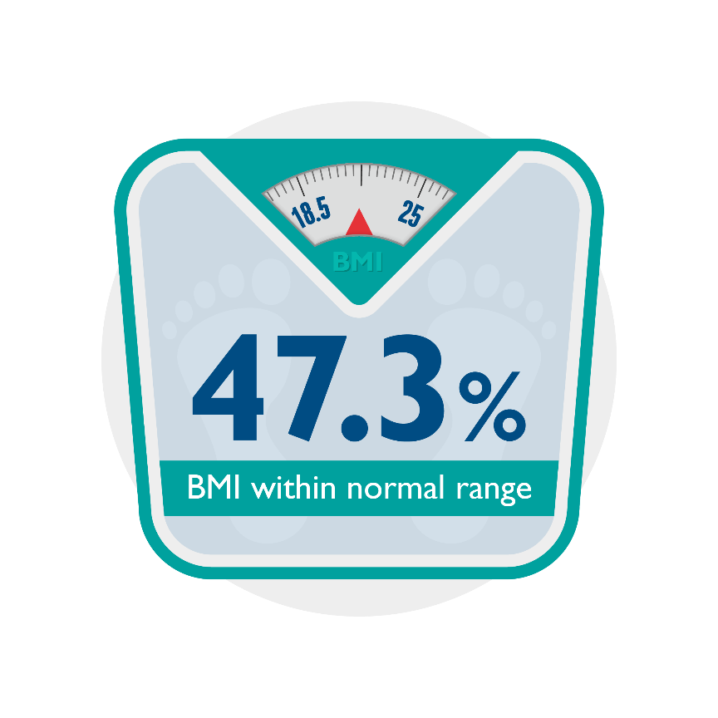
First national record of booking BMI
47.3% of pregnant women had a normal BMI (18.5-25)
21.3% had a booking BMI of 30 or over
Clinical Report 2017
Based on births in England, Scotland and Wales
from 1st April 2015 to 31st March 2016
Maternal BMI at booking

Slide 66
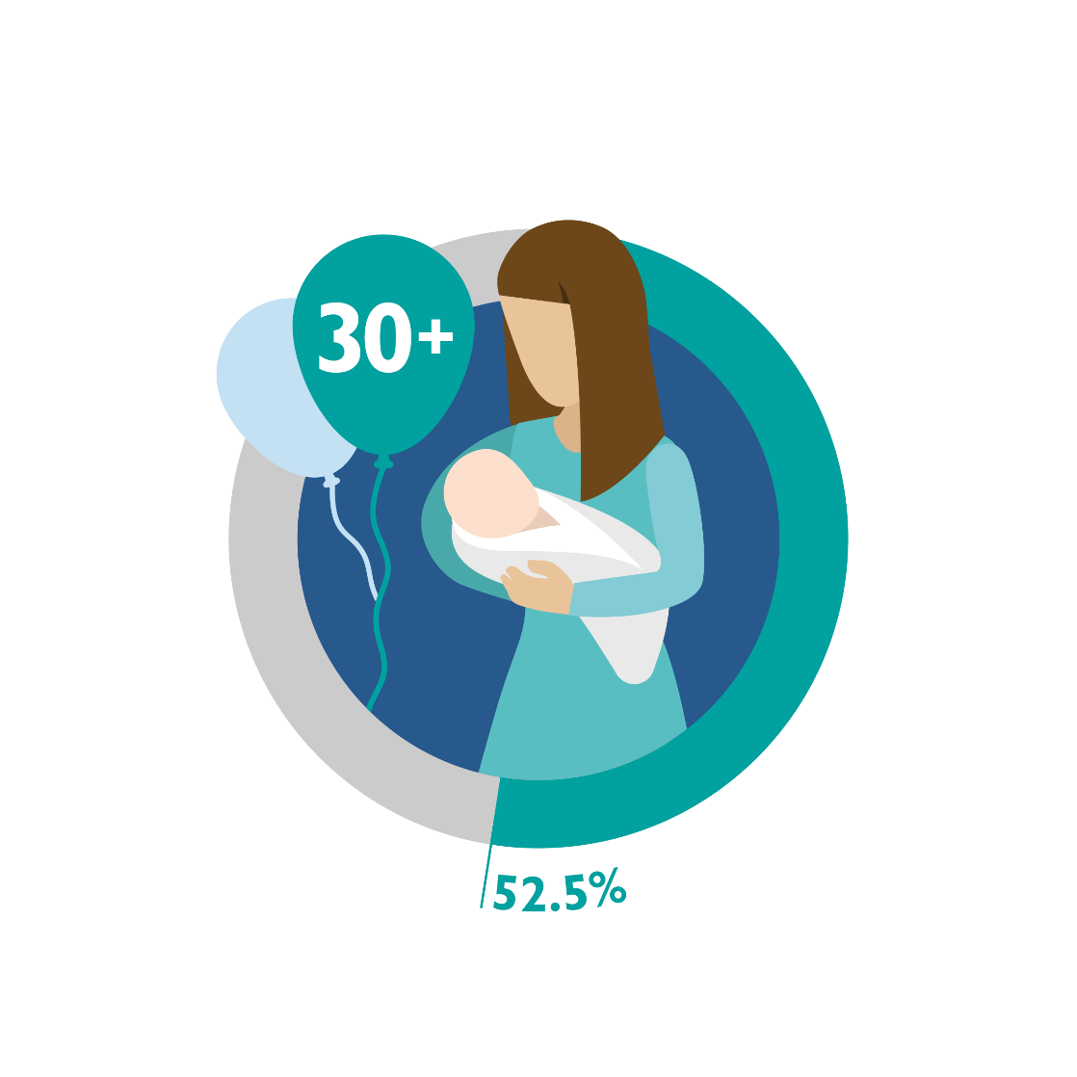
52.5% of women giving birth are aged 30 or over
1/7 are over the age of 35
In England and Scotland, 2.7% primiparous women were 40 or over.
Maternal age at time of birth

Slide 67
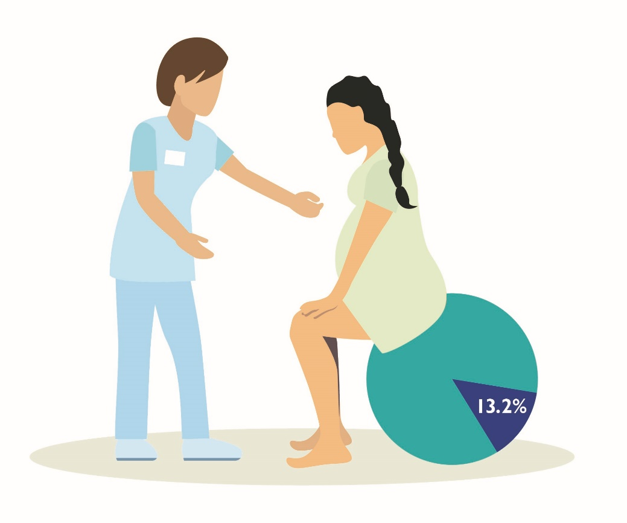
Increasing access to midwife-led birth settings is a national priority
… only around 13% of women give birth in a midwife-led setting
Place of birth

Slide 68
6.3% of singleton babies were born preterm
57.8% of multiple birth babies were born preterm
Preterm birth

Slide 69
Measures of Care: Findings

Slide 70
Audit measure category | Measure title | England | Scotland | Wales
Antenatal care | Proportion of women who were smokers at booking who smoke at the time of birth
Intrapartum Care | Proportion of women with induced labour
 | Proportion of women with a spontaneous vaginal birth
 | Proportion of vaginal births with an episiotomy
 | Proportion of women having an instrumental birth
 | Proportion of women having a caesarean section
 | Proportion of elective deliveries performed at <39 weeks of gestation without a documented clinical indication
 | VBAC rate
Maternal morbidity | Proportion of vaginal births with a 3/4th degree perineal tear
 | Proportion of women with severe PPH (>1500ml)
 | Proportion of women readmitted to hospital as an emergency within 42 days of giving birth
Neonatal | Proportion of small-for-gestational age babies born ≥37 weeks who are not delivered before 40+0 weeks
 | Proportion of singleton, term, liveborn infants with a 5-minute Apgar score of less than 7
 | Proportion of liveborn babies with skin to skin contact within 1 hour of birth
 | Proportion of liveborn babies who are given breast milk for first feed
 | Proportion of liveborn babies who are given breast milk at discharge home

Slide 71
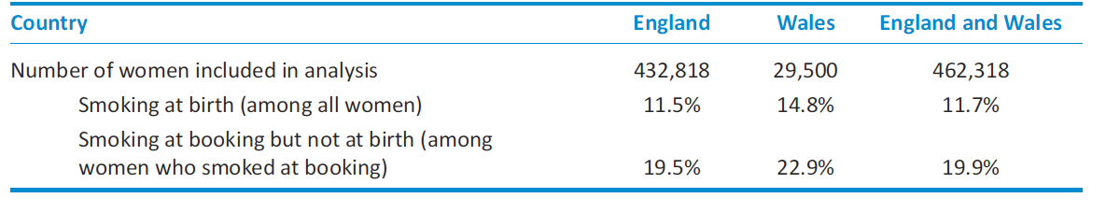
Smoking Cessation in Pregnancy
What is measured: Of women who are recorded as being current smokers at their booking visit, the proportion who are no longer smokers by the time of birth.

Slide 72
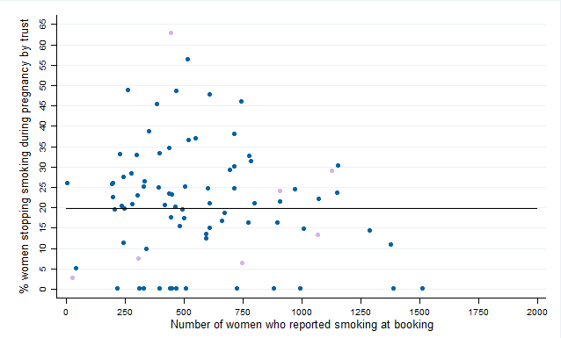
Smoking cessation in pregnancy
Of women who are recorded as being current smokers at their booking visit
the proportion who are no longer smokers by the time of birth.
England (trusts) Wales (health boards)

Slide 73
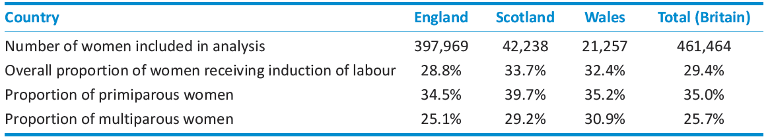
Induction of labour
What is measured: The proportion of women with a singleton baby in the cephalic position between 37+0 and 42+6 weeks of gestation, whose birth commenced with an induction of labour.

Slide 74
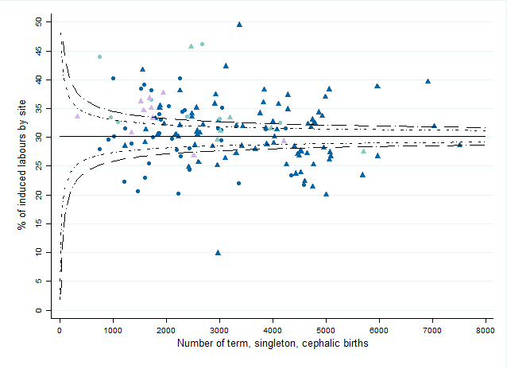

Induction of labour
Of women with a singleton baby in the cephalic position between 37+0 and 42+6 weeks of gestation
The proportion whose birth commenced with an induction of labour.

Slide 75
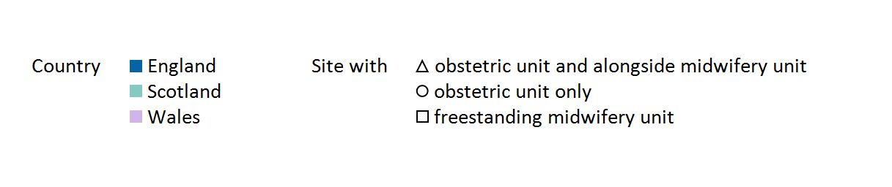

Slide 76
Induction of labour
Of women with a singleton baby in the cephalic position between 37+0 and 42+6 weeks of gestation
The proportion whose birth commenced with an induction of labour.

Slide 77
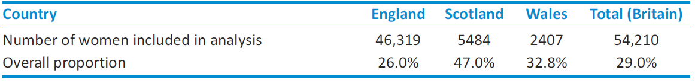
Elective deliveries (inductions and caesarean sections) performed before 39+0 without clinical indication
What is measured: Of women who give birth either by elective caesarean section or induced labour to a singleton baby between 37+0 and 38+6 weeks of gestation, the proportion for whom there was no documented clinical indication for this.

Slide 78
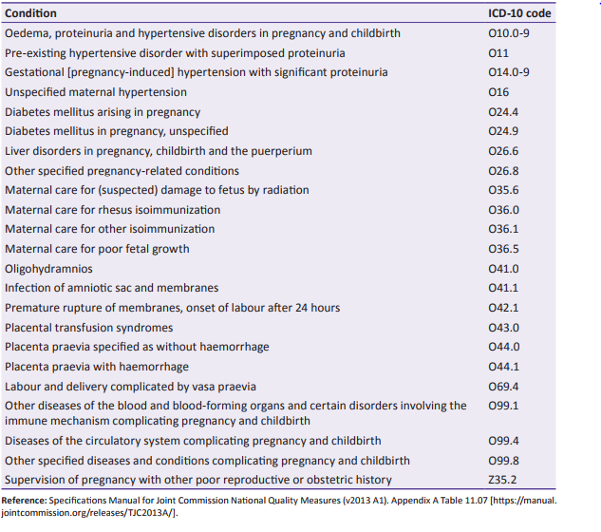

Slide 79
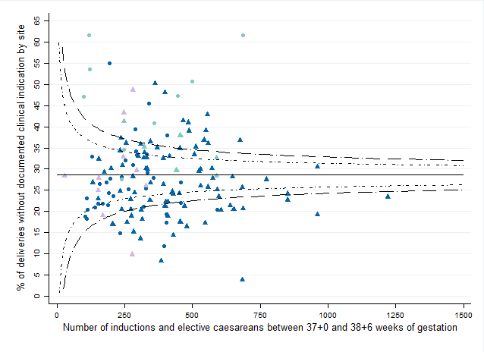
Elective deliveries (induction or caesarean section) performed before 39+0 without documented clinical indication
Of women who give birth either by elective caesarean section or induced labour to a singleton baby between 37+0 and 38+6 weeks of gestation
The proportion for whom there was no documented clinical indication for this.

Slide 80
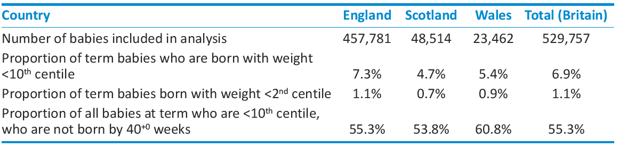
Babies born small
What is measured: Of term babies born small for gestational age (defined as less than the 10th birthweight centile using UK 1990 charts), the proportion that are born after their estimated due date.

Slide 81
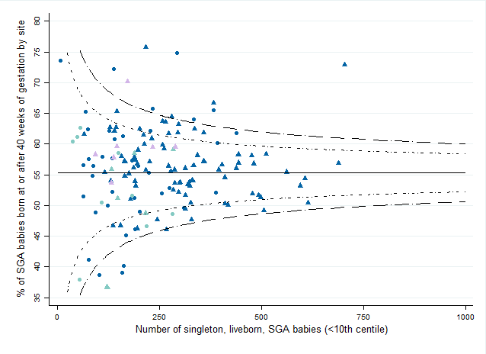
Babies born small
Of term babies born small for gestational age (defined as less than the 10th birthweight centile using UK 1990 charts)
The proportion that are born after their estimated due date.

Slide 82
Modes of birth
What is measured: Of women who give birth to a singleton baby in the cephalic position between 37+0 and 42+6 weeks of gestation, the proportion with each mode of birth:
  Spontaneous vaginal: vaginal and without the use of instruments
Instrumental: vaginal with the assistance of instruments
Caesarean (both elective and emergency)

Slide 83
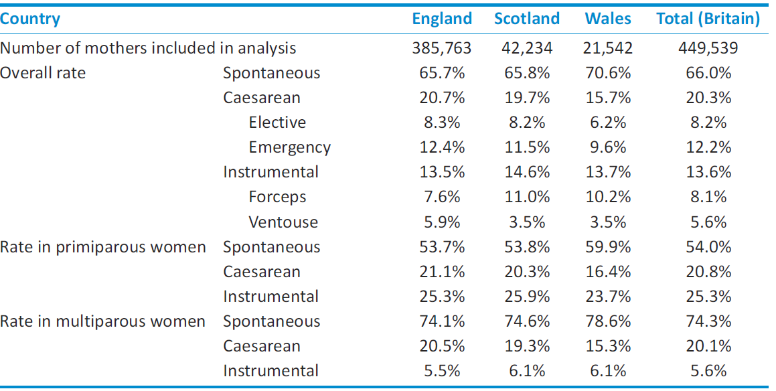

Slide 84
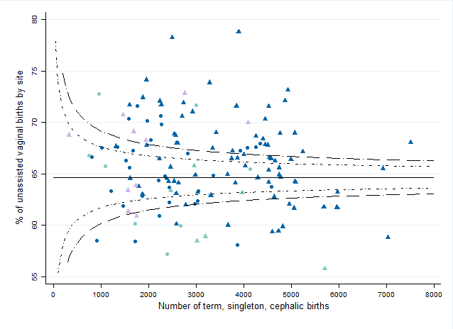
Modes of birth: spontaneous vaginal birth
Of women who give birth to a singleton baby in the cephalic position between 37+0 and 42+6 weeks of gestation
The proportion with spontaneous vaginal birth

Slide 85
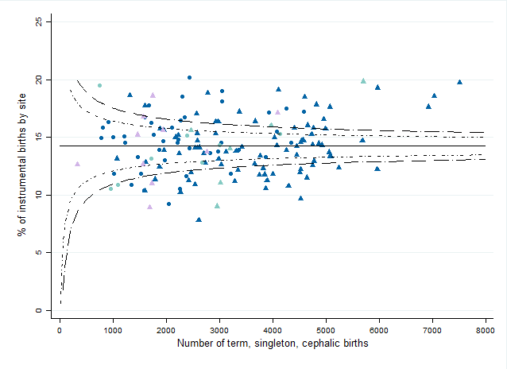
Modes of birth: instrumental vaginal birth
Of women who give birth to a singleton baby in the cephalic position between 37+0 and 42+6 weeks of gestation
The proportion who give birth vaginally with assistance of instruments

Slide 86
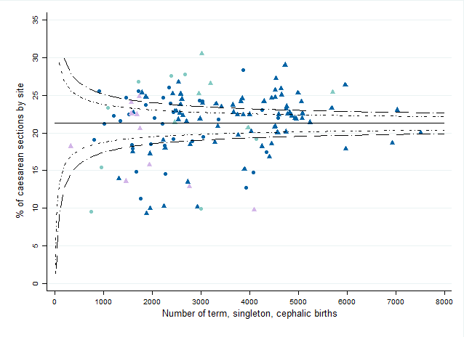
Modes of birth: caesarean birth
Of women who give birth to a singleton baby in the cephalic position between 37+0 and 42+6 weeks of gestation
The proportion who give birth by caesarean

Slide 87
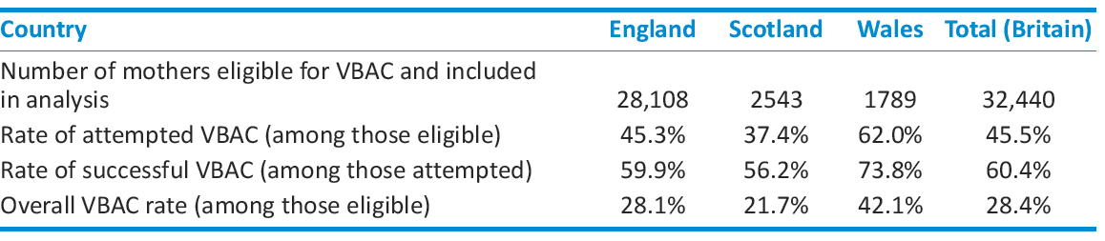
Vaginal birth after caesarean
What is measured: Of women having their second baby after having had a caesarean section for their first baby, the proportion who give birth to their second baby vaginally.

Slide 88
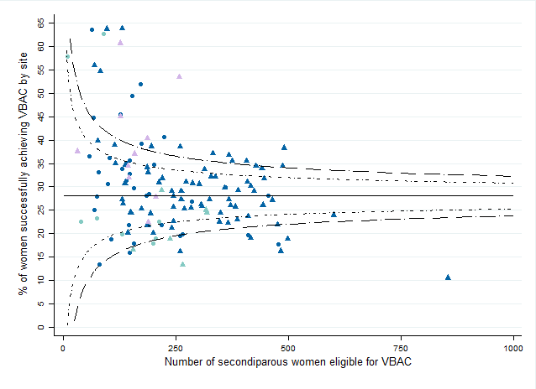
Vaginal birth after caesarean
Of women having their second baby after having had a caesarean section for their first baby
The proportion who give birth to their second baby vaginally.

Slide 89
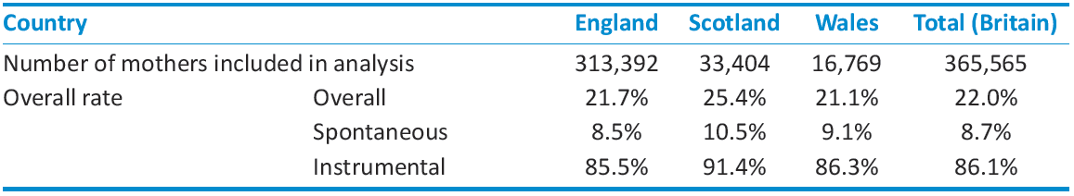
Episiotomy
What is measured: Of women who give birth vaginally to a singleton baby in the cephalic position between 37+0 and 42+6 weeks of gestation, the proportion who had an episiotomy.

Slide 90
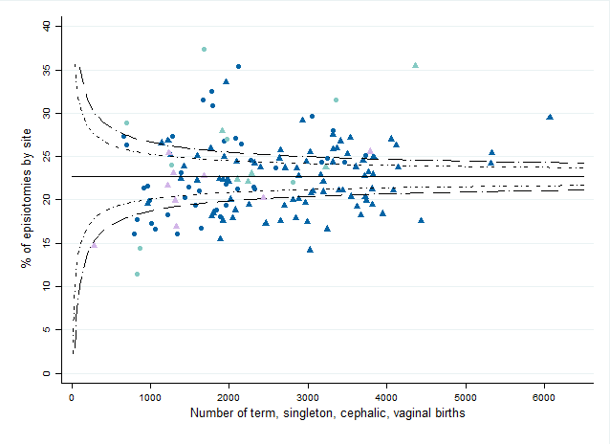
Episiotomy
Of women who give birth vaginally to a singleton baby in the cephalic position between 37+0 and 42+6 weeks of gestation
The proportion who had an episiotomy.

Slide 91
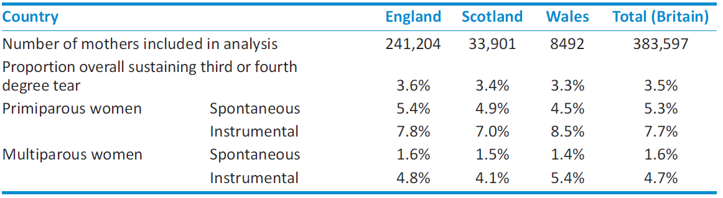
Third- and fourth- degree tears
What is measured: Of women who give birth vaginally to a singleton baby in the cephalic position between 37+0 and 42+6 weeks of gestation, the proportion who sustained a third or fourth degree tear.

Slide 92
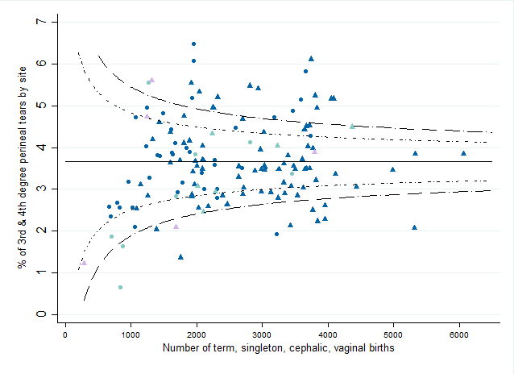
Third- and fourth- degree tears
Of women who give birth vaginally to a singleton baby in the cephalic position between 37+0 and 42+6 weeks of gestation
The proportion who sustained a third or fourth degree tear.

Slide 93
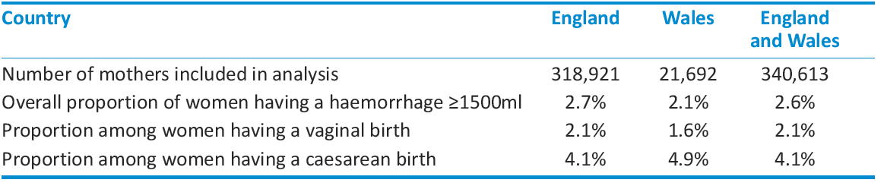
Obstetric haemorrhage ≥1500ml
What is measured: Of women who give birth to a singleton baby in the cephalic position between 37+0 and 42+6 weeks of gestation, the proportion who sustained an obstetric haemorrhage of 1500ml or more.

Slide 94
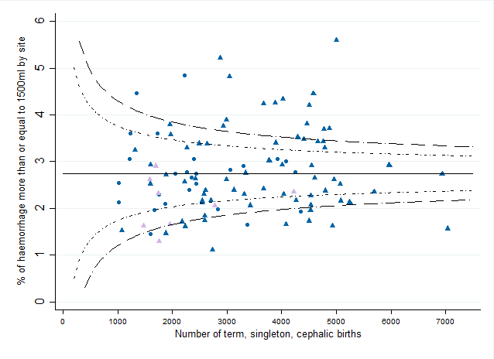
Obstetric haemorrhage ≥1500ml
Of women who give birth to a singleton baby in the cephalic position between 37+0 and 42+6 weeks of gestation
The proportion who sustained an obstetric haemorrhage of 1500ml or more.

Slide 95
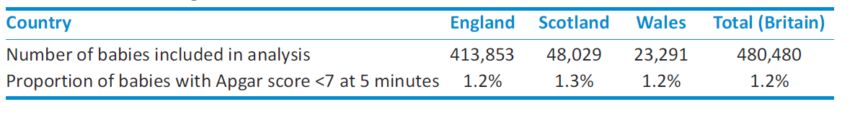
Five minute Apgar score
What is measured: Of liveborn, singleton babies born between 37+0 and 42+6 weeks of gestation, the proportion who are assigned an Apgar score of less than 7 at five minutes of age.

Slide 96
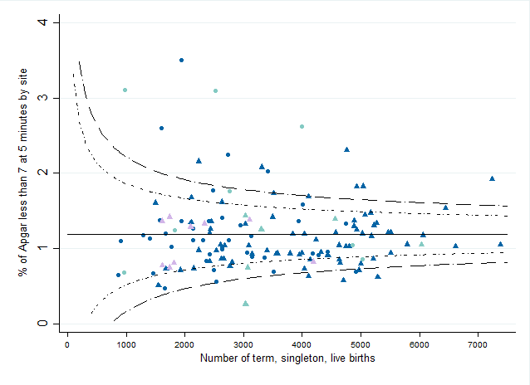
Five minute Apgar score
Of liveborn, singleton babies born between 37+0 and 42+6 weeks of gestation
The proportion who are assigned an Apgar score of less than 7 at five minutes of age.

Slide 97
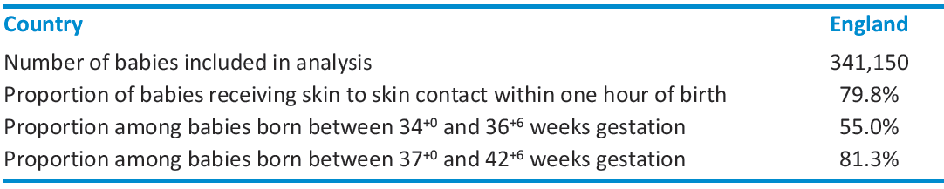
Skin to skin contact within 1 hour of birth
What is measured: Of liveborn babies born between 34+0 and 42+6 weeks of gestation, the proportion who received skin to skin contact within one hour of birth.

Slide 98
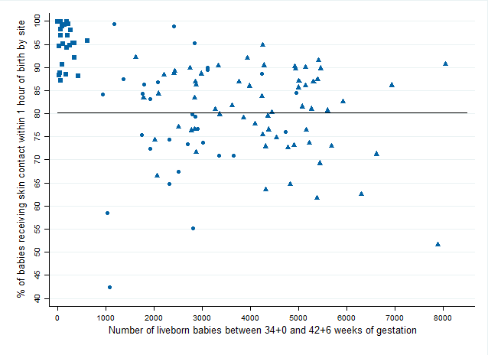
Skin to skin contact within 1 hour of birth
Of liveborn babies born between 34+0 and 42+6 weeks of gestation
The proportion who received skin to skin contact within one hour of birth.

Slide 99
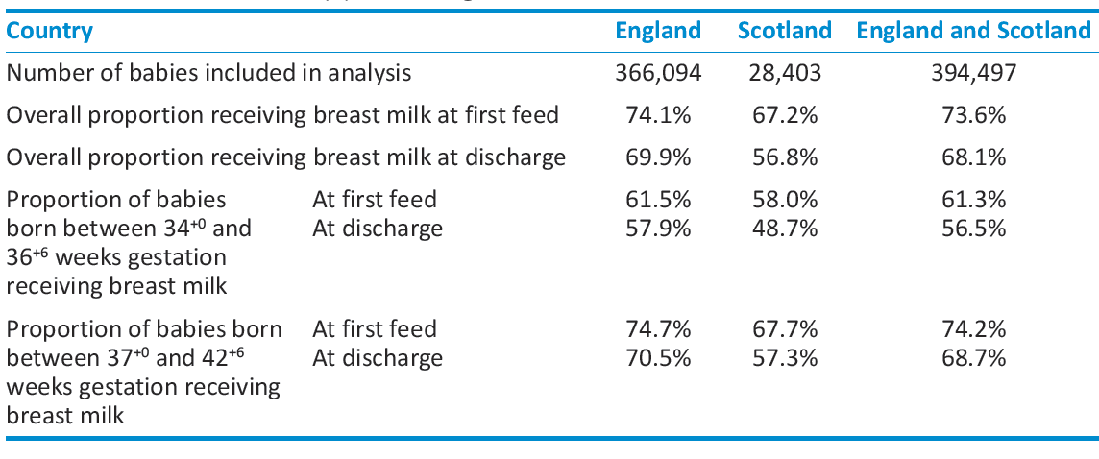
Breast milk at first feed, and at discharge
What is measured: Of liveborn babies born between 34+0 and 42+6 weeks of gestation, the proportion who received any breast milk for their first feed, and at discharge from the maternity unit.

Slide 100
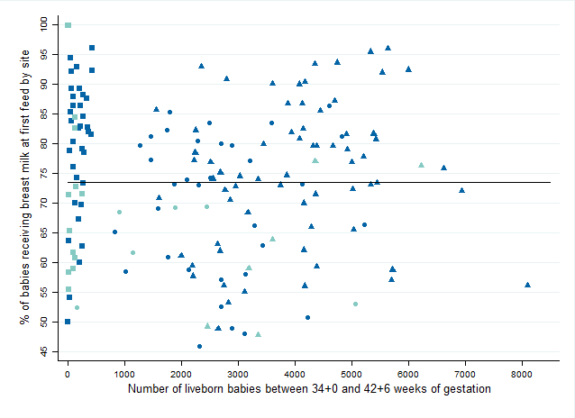
Breast milk at first feed, and at discharge
Of liveborn babies born between 34+0 and 42+6 weeks of gestation
The proportion who received any breast milk for their first feed, and at discharge from the maternity unit.

Slide 101
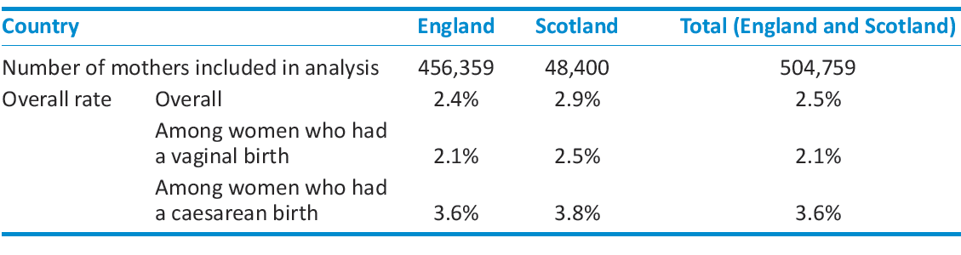
Unplanned maternal readmission
What is measured: Of women giving birth, those who have an unplanned, overnight readmission to hospital overnight within 42 days of giving birth, excluding those accompanying an unwell baby.

Slide 102
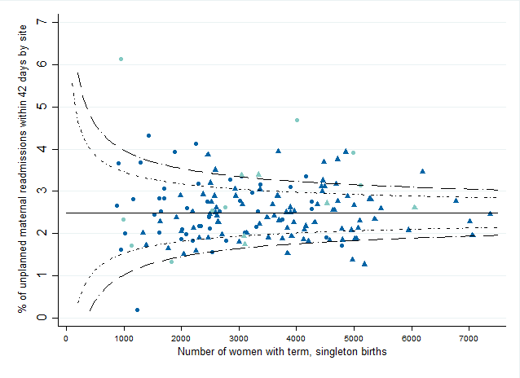
Unplanned maternal readmission
Of women giving birth
The proportion who have an unplanned, overnight readmission to hospital within 42 days of giving birth, excluding those accompanying an unwell baby.

Slide 103
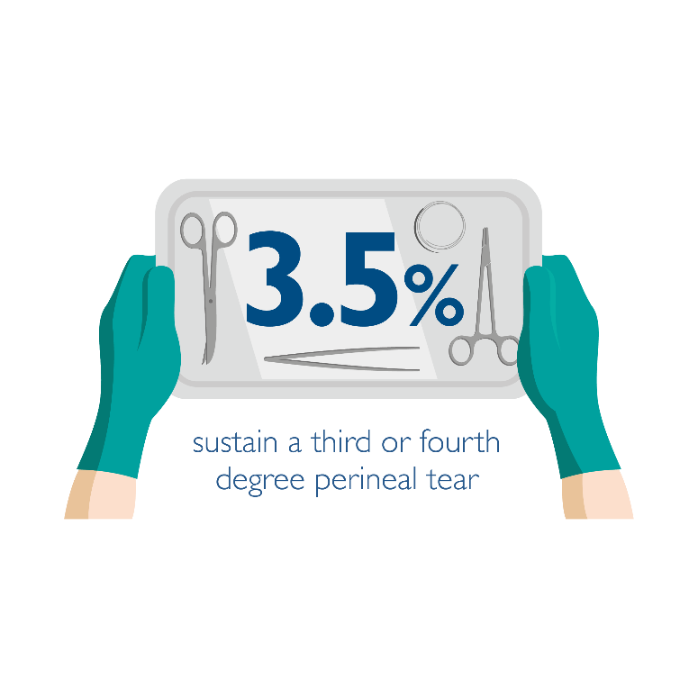
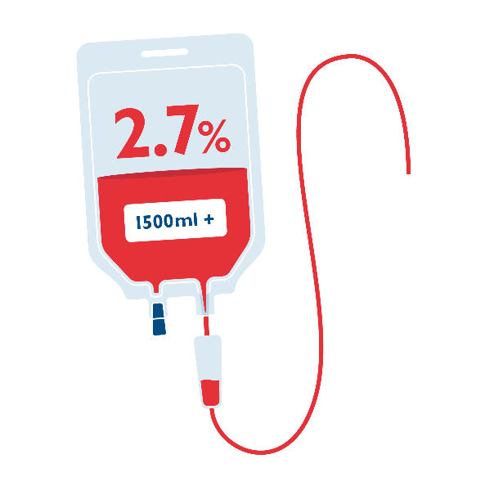
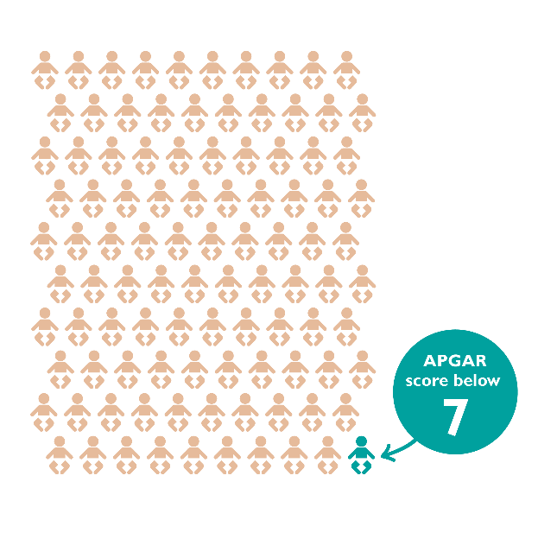
Summary
Risk adjusted results on key measures in maternity and neonatal care
Full results available on our website www.maternityaudit.org.uk
2016-17 results in Autumn 2018

